Slide 1
Topics:- 1.Ipl Score board 2.To do list 3.Solar energy website
Mini Project
Presented By:-
1.Sachin Saurabh
2.
3.
Submmite To:-
Hanumant pawar

Slide 2
1.Ipl Score board
Using Html Language.
Using Java Script Concept.
And many more concept present in Html lang.

Slide 3
Description
Make a two team score board.
Eg:- Mumbai Indians and Chennai Super Kings.
There is a toss button. And there is a preduction in two teams and there is two buttons bat and ball . Which team win the toss you decide to bat or ball to that team.
In Website there is a Timer button of 10 mins when you press start match button.
Which Team decided to bat first his pannel are open to score there is a 6 buttons 5 is for runs 1,2,3,4 & 6 runs and one button is for deduct score.

Slide 4
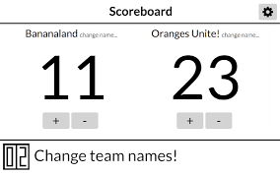
Sample pictures

Slide 5
2.To Do List
Using Html Language.
Using Java Script Concept.
And many more concept present in Html lang.

Slide 6
Description
A sign up page.
3 checkbox to write some tasks.
A clender to set the day wich you want to perform your task.
And a clock which you set your time to do your task.

Slide 7
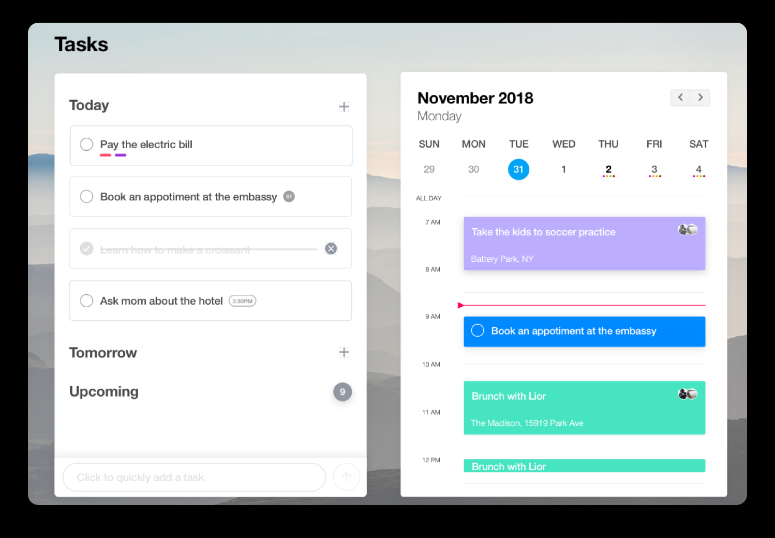
Sample picture

Slide 8
3.Solae energy website
Using Html Language.
Using Java Script Concept.
And many more concept present in Html lang.
Using logo of some contents.

Slide 9
Description
There is 6 buttons and 6 tabs. Eg:-Home,About,Project,Services, client & contact me.
6 buttons has different informations to read.
A twitter logo shown is all tabs and many more logo shown in some contents.
Open a blue link to open some internet contents.
Click on call and mail button open a small new drop box that you contact through company.

Slide 10
